Slide 1
OBJECT ORIENTED ANALYSIS AND DESIGN
Social Network Website

Slide 2
OBJECT ORIENTED ANALYSIS AND DESIGN
Instructor: Truong Ninh Thuan
Project Team:
Tran Quang Cuong 13020049
Nguyen Thanh Trung 13020463
Nguyen Vu Hoang Vuong 13020763

Slide 3
Outline
Problem Statements
Analysis
Design

Slide 4
Problem Statement
Problem
Use-Case

Slide 5
Problem Statement
Problem
Use-Case

Slide 6
Problem
Online social networking is extremely popular in daily life.
The need to communicate with people.
Effective ways for business promotion, online marketing, etc.
So we chose Social Networking to problem to analysis and design.

Slide 7
Problem Statement
Problem
Use-Case

Slide 8
Use-Case
Registration
Login
Update User Profile
Friend Manager
Posting
View Post
Edit/Delete Post
Like Post
Comment
View Notifications
Chatting

Slide 9
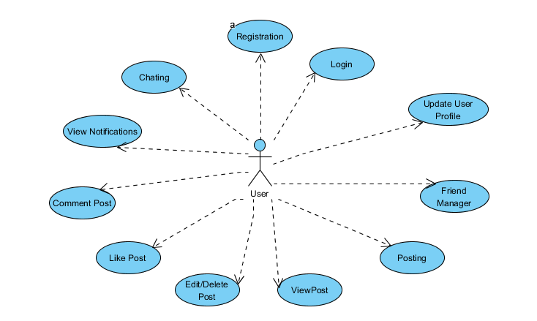

Slide 10
Use-Case: Registration
Everyone can register for free
Only a valid email is needed.

Slide 11
Use-Case: Login
User can login to the system after registration
Provide correct email and corresponding password

Slide 12
Use-Case: Update User Profile
Change email, password, etc
Need password confirmation

Slide 13
Use-Case: Friend Manager
Send a Friend Request
Accept a Friend Request
Delete a Friend
Block a Friend

Slide 14
Use-Case: Posting
Write everything you want!.
Only friends can see it

Slide 15
Use-Case: View Post
Post can be view by author or author’s friends

Slide 16
Use-Case: Edit/Delete Post
Post can be edit.
Post can be delete.
When delete a post, all associated comments also be deleted.

Slide 17
Use-Case: Like Post
There is a Like button for each post
Everyone who can view post can click Like

Slide 18
Use-Case: Comment
Comment to give opinion about a post

Slide 19
Use-Case: View Notifications
There are 4 types of notifications:
Friend Request Notification
Accept Friend Request Notification
Like Notification
Comment Notification

Slide 20
Use-Case: Chatting
Private conversation between 2 users
Old messages are store on database

Slide 21
Architecture Analysis
MVC (Model-View-Controller) pattern
Key Abstraction
User
UserRelation
Post
Comment
FriendRequest
LikeNotification
CommentNotification
Message

Slide 22
Design
Subsystem design
Packages design

Slide 23
Maintain Catalog Subsystem

Slide 24
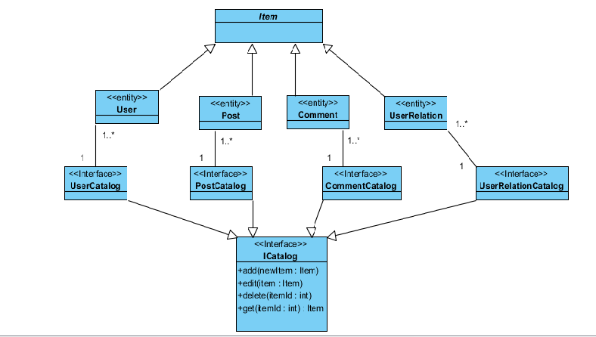

Slide 25
Notification Subsystem

Slide 26
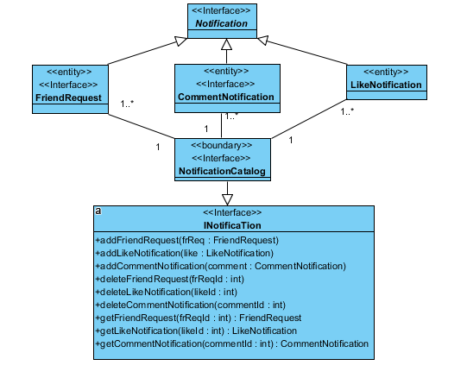

Slide 27
Chat Subsystem

Slide 28
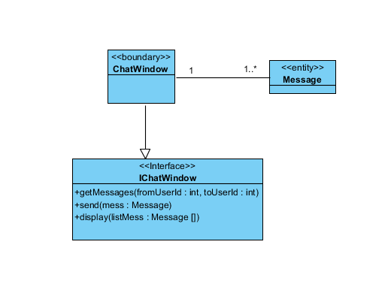

Slide 29
Packages Design

Slide 30
